Slide 1
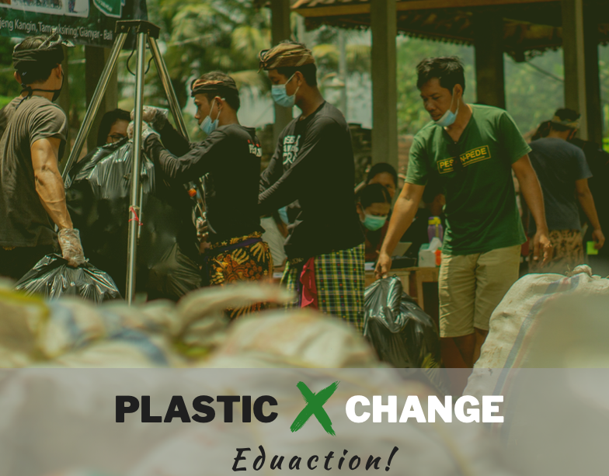
Kernel of Validation
A community-based data validation process, using Plastic Exchange as a case study

Slide 2
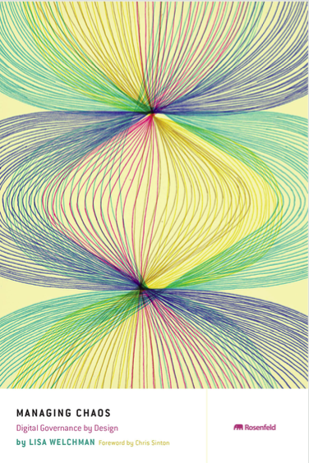
Effective Governance stems from Data Validity
Digital Governance is a framework for establishing:
Accountability,
Roles,
Decision-Making Authority,
for an organization’s digital presence.
Excerpt from chapter 1 of Managing Chaos by Lisa Welchman

Slide 3
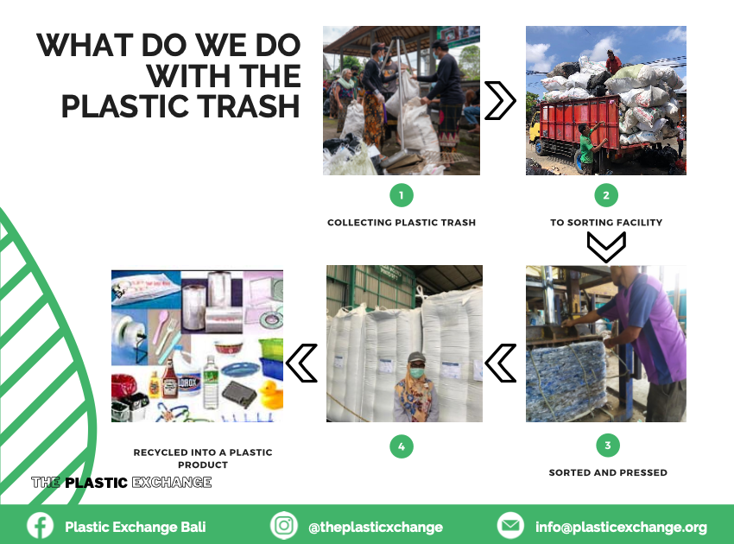
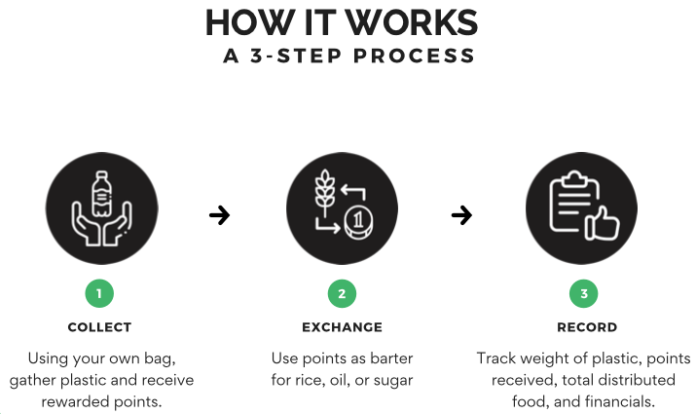
Plastic Exchange Bali mobilized local communities
Since June 2020, more than 250 tons of plastic and paper carton has been collected and centrally recycled.

Slide 4

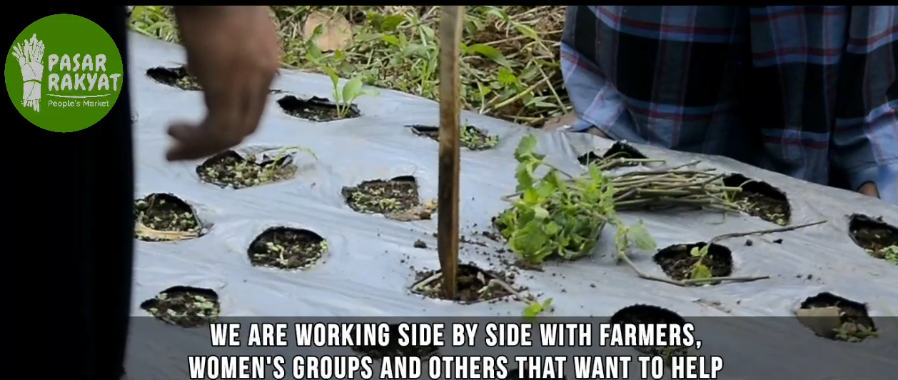
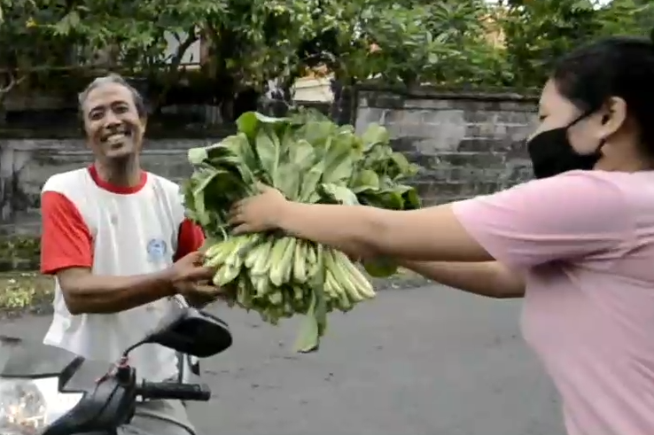
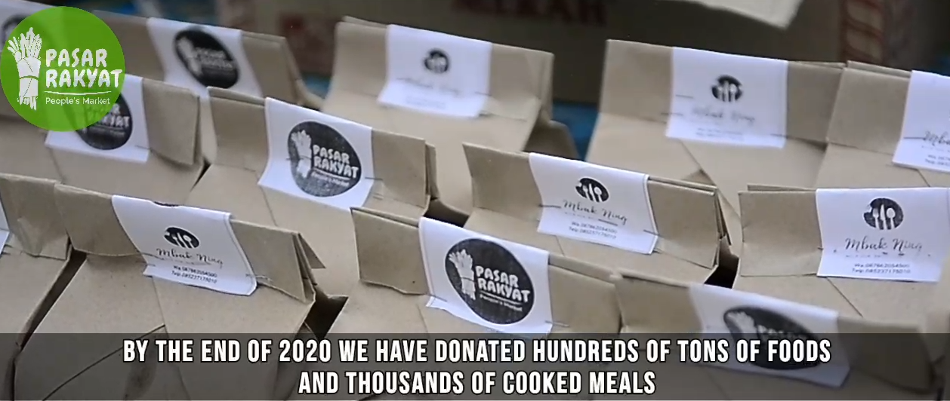
Parsar Rakyat Bali, Food Security System
Since April 2020, more than hundred tons of free/low-cost food has been donated to people with needs.
How to keep track of farmer’s contribution?
How to identify people with needs?
How to deliver food to households?
How to process food safely and effectively?

Slide 5
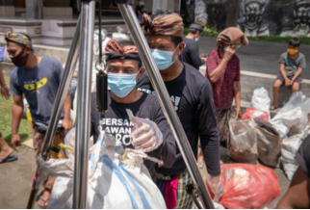
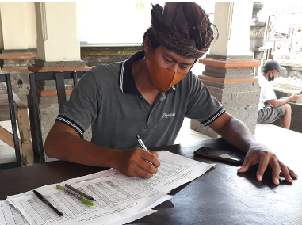
Current Data Collection Practice
Many community services use manual data collection, interpretation and paper-based data storage
For short term and small scale operations, manually recorded data has proven to work.

Slide 6
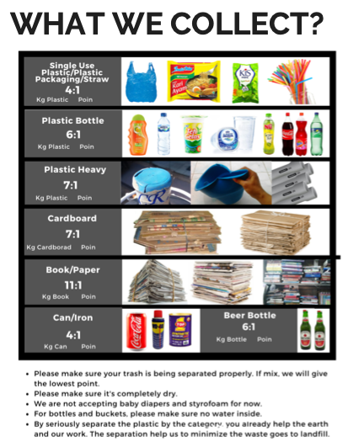
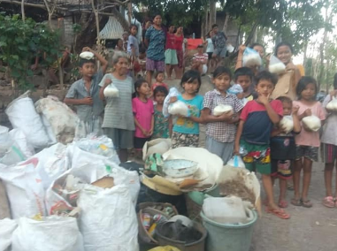
Where are the improvement opportunities?
A number of issues will challenge the scalability and stability of the community program:
When more types of “waste” materials are to be collected, the recording process will be more complex, and therefore prone to errors.
When many more people are involved, the total amount of rice or other goods purchased will create a larger inventory, creating a potential incentive of corruption.
Currently, the total amount of rice dispensed and money collected is small enough for manual accounting practice.
Manual accounting and inventory management prevent more efficient fund raising and more complex exchange practices.

Slide 7
A seemingly complex Data Collection Process
Many community services use manual data collection, interpretation and paper-based data storage
People Gather Plastic
Identify Plastic Gatherer’s Identity (ID)
Take a picture while Weighting
Plastic
Submit the picture to Web Server
Presenting ID to collect Rice
Compile Data Content on Web site
Present time-based Data Summary
Record a complete Exchange Cycle on the Ledger
Confirm Reception on Web Form with ID
Dispose Rice to Plastic Collector

Slide 8
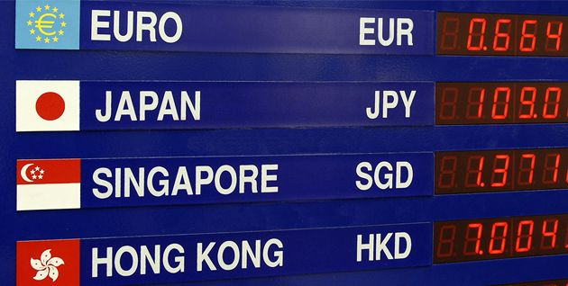
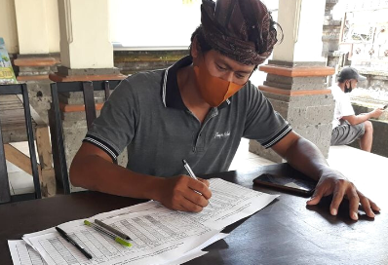
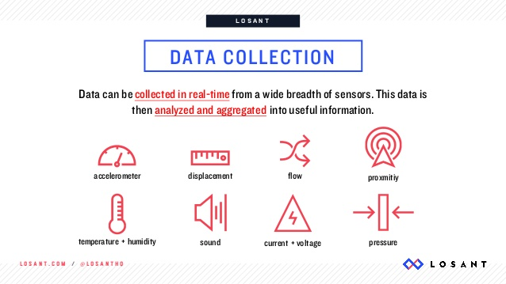
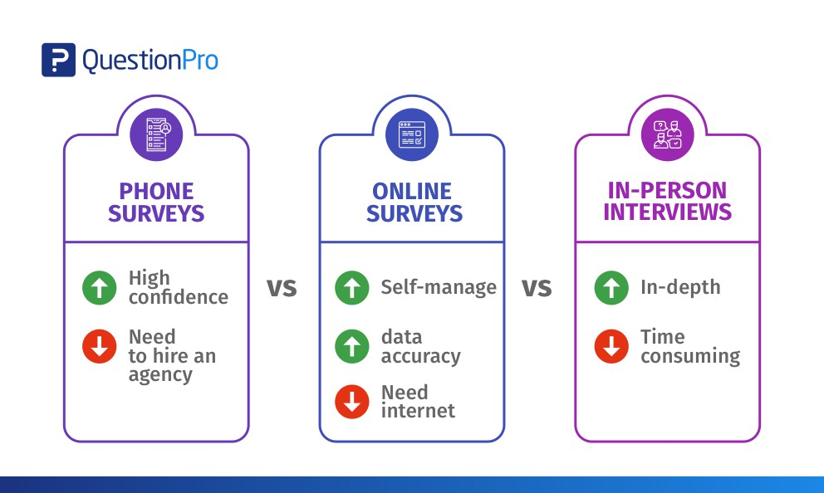
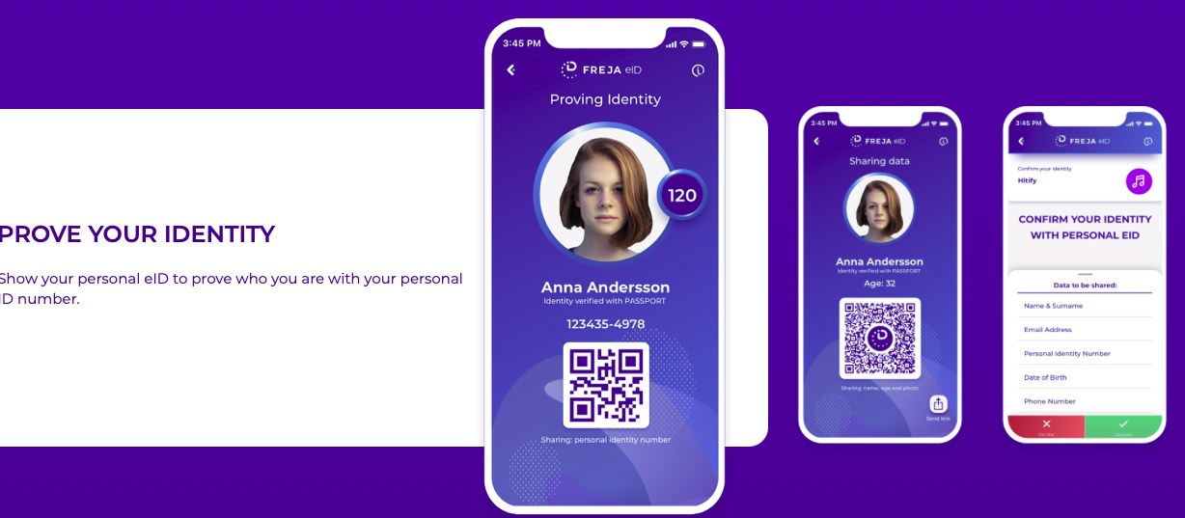

A possible solution based on one Web Server
Three main functions: Account ID management, Organizational Roles, and Decision-Making Support.
People Gather Plastic
Identify Plastic Gatherer’s Identity (ID)
Take a picture while Weighting
Plastic
Submit the picture to Web Server
Presenting ID to collect Rice
Exchange Rate Table
Plastic Exchange Rates
Collector ID management
Transaction Ledger
Methods of Data Collection
A “Central” Web Server
Issue Digital ID
RAIN
RAIN
Compile Data Content on Web site
Present time-based Data Summary
Record a complete Exchange Cycle on the Ledger
Confirm Reception on Web Form with ID
Dispose Rice to Plastic Collector

Slide 9
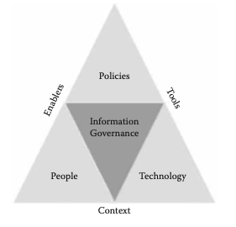
Context: The Value of Trust-worthy Data
Social stability/coherence comes from effective information governance:
Institutionalized Regulations
Consumers and Data Observers
Infrastructure Operators
p. 225, Fig. 9.1 of Data Governance, by Neera Bhansali

Slide 10


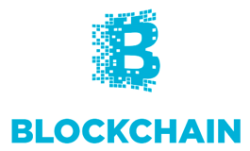



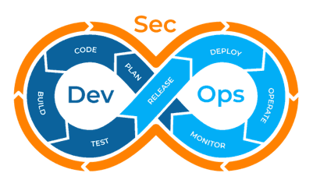
Data Collection Mechanisms and Sources of Truth
Data becomes trust-worthy, when multiple independent data sources presents agreeable observed data content
Institutionally Certified Data Quality Standards
Technically Sound Data Processing Workflow
Community Accepted Data Exchange Protocol

Slide 11
Key strategies in rolling out this initia Data Platform
Use one website to conduct must data collection and presentation work.
Reduce the amount of technologies and actions need to be learned in these distributed locations.
Whenever possible, let partcipants use their personal cellphone.
When participants (Plastic Collectors) don’t have cellphones, use event organizer’s designated cellphone/laptop computers to recognize the participants’ ID.
This “one website” will try to be the single source of data format, to be shared and open sourced for many similar projects.
This “one website” will be implemented using time-lasting and known data security/software safety practices, so that it can be scaled to serve sustainable developmental purposes.

